Slide 1
CS2040/C
Guideline slides only

Slide 2
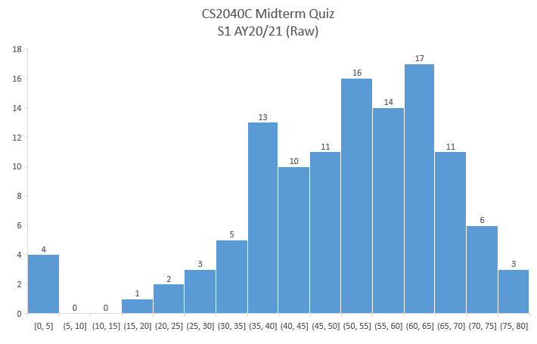
Admin – Midterm Analysis (Got +0/+1 regrade from 1c issue, but does not change the picture below by much)
Moderation: Paper 15% marks is raw/95*15%, not raw/100*15% Max Q1 is 14/15 Max Q7 is 10/15 i.e., 6 5 impossible marks for this cohort
Failure risk, BUCK UP!
Potential TA

Slide 3
Admin – Midterm Analysis
Midterm scores have been returned “electronically”
I have “deleted” the gradebook with 1c error to avoid uploading the wrong thing later when the semester ends
ans_modal.txt attached in the zip file (midterm quiz modal answers)
For more exercises :O
Read CP4 Book 1 (or 2 :O)
Use https://cpbook.net/methodstosolve search feature :O
Or peruse https://github.com/stevenhalim/cpbook-code for Steven’s C++17, Java11, Python3, or OCaml code that I use in my CP-book

Slide 4
Review of Table ADT part 2
https://visualgo.net/en/bst?slide=1 to 3-10
Q&A on the basic stuffs:
QUICK review: Do you understand the main difference of Table ADT implementation between Hash Table (previous lesson) and (balanced) BST (this lesson)?
Not asked:
On why we cannot really use (Singly) Linked List for efficient Table ADT (either sorted vs unsorted LL); What if we use DLL?
Once again, on why sorted/unsorted array/vector is not good for efficient Table ADT implementation, especially the one that requires ordering criteria
Notes:
Hash table = the keys are unordered (actually faster than bBST, O(1) vs O(log n), bBST = the keys are ordered (more possible Table ADT applications, see slide 3-5 of BST e-Lecture), will be re-highlighted again in Lab soon
Spares
Assuming sorted SLL: Search, we can’t use random access in SLL, so even if the SLL is sorted, we cannot run binary search, O(N); Insert needs to search insertion point first, O(N), Remove also O(N), need to find it first. DLL actually doesn’t help much… For S2 AY2018/19, this is what was tested in Midterm Test…
Already discussed in during the discussion of unordered Table ADT; This time asked for Table ADT that requires additional operations that require ordering… Think about it!

Slide 5
Review of BST structure and basic operations
https://visualgo.net/en/bst?slide=4 to 5-3
Q&A on basic BST stuffs:
Do you fully understand the basic structure of BST data structure?
Do you understand the basic BST operations, the query ones especially Inorder Traversal?
How about the update ones: Insert, Create, and in details: Remove? (classic queries since many AYs)
Do you realize that the BST keys do not have to be integer?
Important point: Do you realize that if the BST is not balanced, its height h can be O(n) so all O(h) operations are O(n)…? Back to square one?
Not asked:
[asked at the end of AVL Tree lecture by someone, review the recording]: What if there are duplicate copies of the keys and we want to store all duplicate copies without overwriting them?
What are the hidden BST operations?
Notes:
It is a recursive structure
Query operations are Search (easiest to understand, the reason on why the name of the data structure is BINARY SEARCH tree); FindMin/Max (which by now you should realize that these two BST operations can be used to implement ADT Priority Queue too :O), Successor and its clone Predecessor (needed for removal of vertex with 2 children later); InOrder traversal (perhaps the O(N) analysis is new, and the revelation that this is actually can be used as part of “TreeSort” algorithm…, insert N random numbers into balanced BST in O(N log N) time and run O(N) InOrder traversal) and new (soon): Pre and Post order; We will just go through these quickly. And FindMin+(N-1) calls of Successors == InOrder Traversal too
The usual questions should involve the 3 removal cases; Steven has tried to re-explain slide 10 to 10-6 as best as he can… will continue refining e-Lecture slides to minimize such questions in the future
You will see/have seen that the keys can be strings… basically anything that can be compared (ordered) can be the key
This is the key transition slide to next lecture about AVL tree
Spares:
(STL answer): Don’t use map/set, use multimap/multiset. The mathematical definition of “set” requires distinct elements. If we use our own implementation, the easiest is to put a frequency counter as satellite data; we really remove if frequency == 1, otherwise we just decrement; we properly insert if frequency == 0, otherwise we just increment; There are other ways but this is probably the easiest
Hidden ones are: Select and Rank operations; Select(k), what is the k-th smallest element currently in the BST; Rank(v), what is the (1-based) rank of element v in the BST, they will be discussed in Tut07/PS4

Slide 6
Live Demo (not Kattis yet)
BSTDemo.cpp or BSTDemo.java
It is just the basic form, make sure you understand the rough ideas
I will soon add BSTDemo.py for IT5003 :O
We will extend this to AVL Tree soon
However, to solve “real problems”, there is no need to use this very long BST implementation (which will TLE if we don’t use the balanced BST/AVL variant)…
So, see Steven’s CP-book demo-code for C++ STL map/set
https://github.com/stevenhalim/cpbook-code/blob/master/ch2/nonlineards/map_set.cpp
For some interesting applications that you can do with std::map or std::set

Slide 7
Live Demo
https://nus.kattis.com/problems/kattissquest
Combo of a few (two) things, but basically just a Greedy algorithm (the algorithm is “given”) simulation using a kind of Priority Queue structure (that allows ‘binary search’ :O)
Solution:
See kattissquest_[vector_TLE|priority_queue_TLE|set_WA].cpp and the detailed comments there
I show a way to secure non zero point during PE (implement verbatim with vector)
I show a few cases that we frequently test in PE (long long “test”)…
I show set versus multiset issue…
If you follow the lecture, you know what to do to get AC for this “easy” PE problem
PS: also see kattissquest_map_of_priority_queues_almost_AC.cpp (can be surprising)
Please appreciate all these technique, many may looks like magic at first ☺
Notes:
Alternative: C++ STL map and C++ STL priority_queue used TOGETHER in a combo DS :O (but not really shown live this time)

Slide 8
Review of AVL Tree and Tree Rotations
https://visualgo.net/en/bst?slide=13 to 15-5
Q&A on AVL Tree:
Do you understand the concept of Tree Rotations?
Do you understand why we may need to do tree rotations during AVL Tree insertion and/or deletion?
Do you fully understand the additional constraints of AVL Tree?
Do you understand the proof on why AVL tree’s height is always O(log n)?
Not asked:
What are the side usage of balanced BST data structure?
Should we use balanced BST for all those side usage blindly?
Notes:
Rotate left and right cases… I hope the animation and the e-Lecture slides are clear enough? Replay it many times until you understand
It is slightly easier during insertion, a bit more work (but still O(log n) during removal), note to self: I have to improve animation; Pro-tip: Use the exploration mode to try making guesses of what VisuAlgo will do before it actually does it to certify yourself 100% understand AVL Tree operations
It maintains height attribute and during insert/remove, it will ensure height difference of left and right subtree is not more than 1
The proof is long and not the tightest one but still among the “easiest” one to explain (for 2 * log n bound)… hopefully the current e-Lecture slides are clear enough
Not asked:
You can use bBST for as O(n log n) “Tree-sort” algorithm (drop all other Sorting algorithms :O) You can abuse bBST as a Linked List too, InOrder traversal is traversal from head (FindMin) to tail (FindMax)… (waste of memory though) You can use bBST as Priority Queue ADT implementation (drop Binary Heap data structure :O as it is a subset of bBST) You can use bBST as Table ADT implementation (drop Hash Table data structure :O)
bBST is not be the most efficient in constant factor sense… Tree-sort have bad cache performance too as bBST is typically implemented using pointers, not as simple array (that has good cache performance if accessed sequentially like in partition algorithm of randomized-quicksort) bBST for Linked List is a waste of memory (left/right/parent/key/height per node at least) bBST has bloated other stuffs because it is more generic, hence beaten by Binary Heap in constant factor time if our intention is to just use standard Priority Queue bBST has O(log n) performance for search/insert/delete in Table ADT, compared to O(1) performance if we use Hash Table Anyway, I still have to teach you other sorting algorithms, Binary Heap, and Hash Table data structures, in the event you need them in your future technical interviews :O
Spares:

Slide 9
Live Demo (not Kattis)
AVLDemo.cpp or AVLDemo.java
Quite long… yeah…
But fortunately we can usually just use these in our application:
C++ STL map/set (or C++ multimap/multiset if there are duplicates)
Java TreeMap/TreeSet
Unfortunately? Python doesn’t have built-in balanced BST yet

Slide 10

Next e-Lecture for our Flipped Classroom
By next week, we will move on to Graph topic
Read https://visualgo.net/en/graphds?slide=1 until … the end :O
See you next week

